Slide 1
AI TB SaaS Platform
Wang Feng
wangfeng2@asiainfo.sg
2020/02/16

Slide 2
Introduction
AII TB (Treasure Bridge) is a micro service application platform under distributed environment. TB provide micro service application development, association, deployment, monitoring, and other application lifecycle management operations . All service are defined by XML, so all operations are online , no compiling, no building , it can assemble applications to help enterprises quickly realize the transformation of traditional centralized architecture, build large-scale, high-availability, experience aggregation cloud applications, intelligent operation and maintenance, rapid business innovation.
Platform
Applications
Treasure Bridge SaaS Platform
App
Info
Deploy
Base
Select Services
& Data Elements
Configurate Context
& Operations & Admin operator
Payment
To Cloud
Tenant
Select Front-End
Select Middle Wares
Deploy Requirement
Artifacts
DevOps
Teamwork
Dev Online
Log
Alarm
Monitor
Report
Reports
Salary
Data Dictionary
SRV Catalogue
Contract
Knowledge
Helps
Authorization
Operator
Staff & Org
Wholesale
XML
Micro Services
Environment
Protocol
Protocol Transform
Access Security
Router
XML Engine
Web Service
Token
Health Check
Restful
SSL
Balance
Services
& Data
Current -limit
Services Manage
I18N
API Setting
Test
Log
Monitor
Statistic
Language
Time Zone
Timeout
ASYN
Mock
Country
Date time
Redo
CRON
Stress
Currency
Tax
Alarm
……
XML Running
Engine
Time schedule
Load XML
initial
One Time
Executor
Input check
Result Format
Request API
Listen
Request and Response and Error Data
Application Data
Context Data
Session Data
Log Data
XMLParse
LogicEngine
Internal Functions
Flow
XMLObject
USDL
Data Structure
Basic
Technology
Base
Middleware
Big Data
AI
IOT
ElasticSearch
HBase
Kafka
Tools……
Busi……
JRE 1.8
MySQL
Redis
ZK
Hadoop
Cloud
Cloud Management Platform
Virtual Resources
Physical Resources

Slide 3
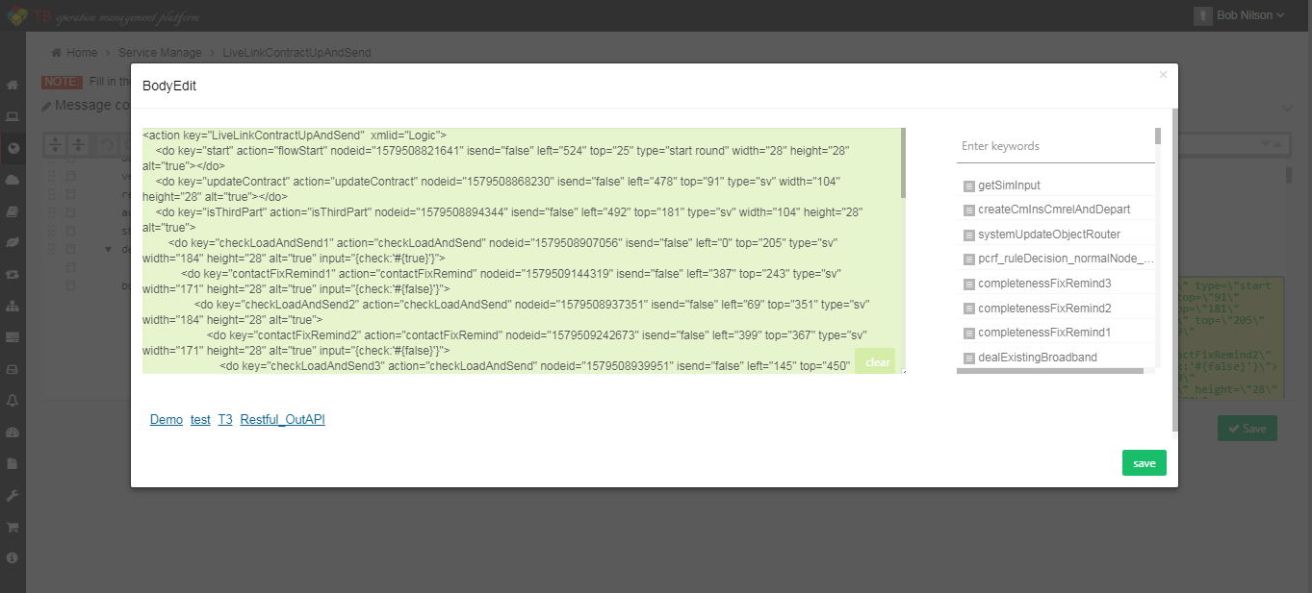
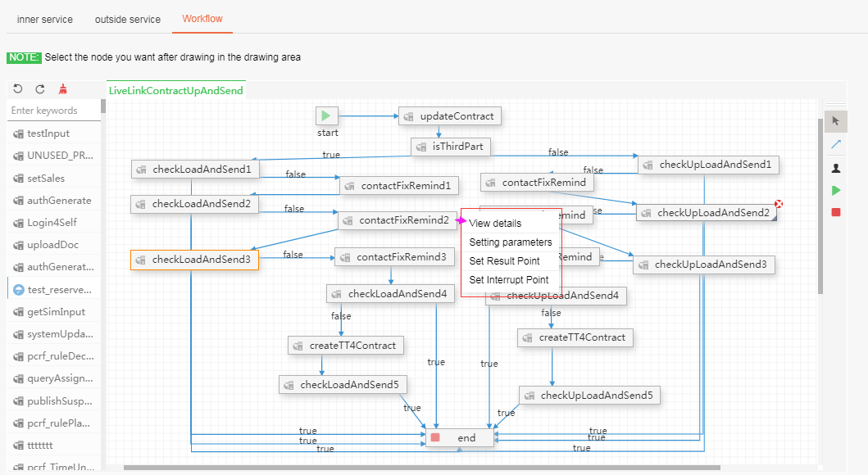
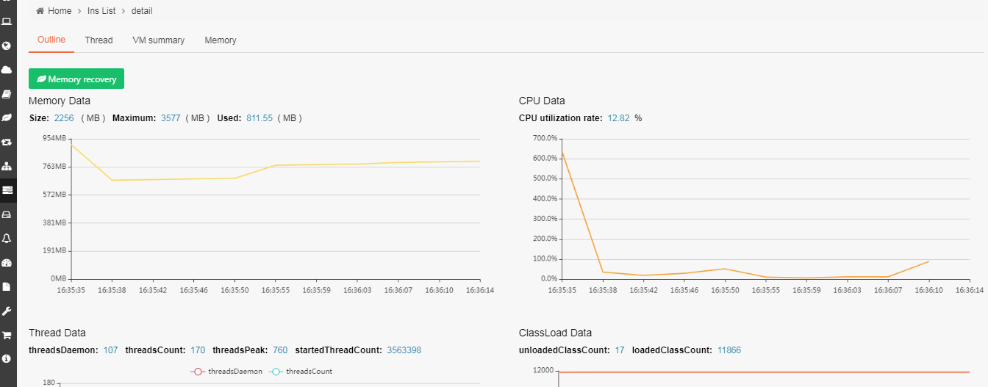
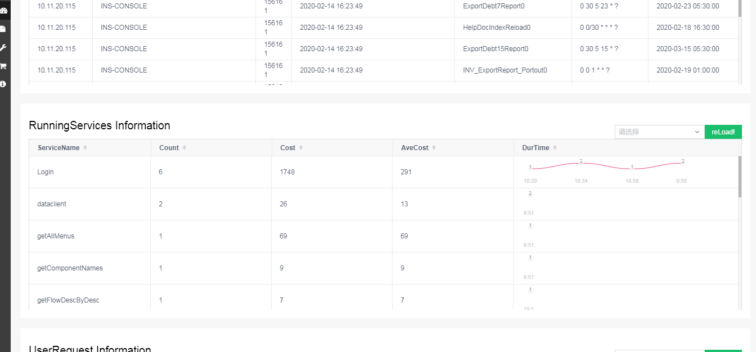
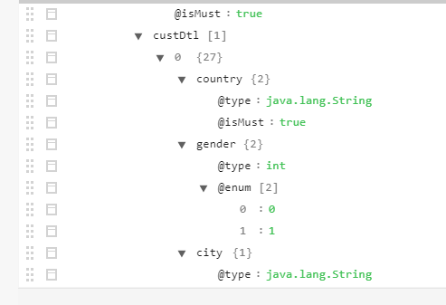
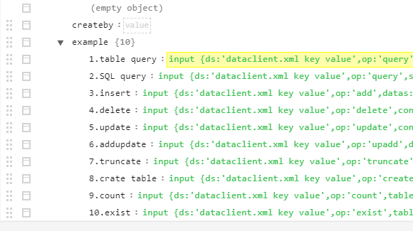
Advantages
Configurability: services are described in XML format, created online, easy to modify, no need to compile, package, deploy and can be tested and stress-tested after creation immediately, saving time, improving efficiency, and making it easy to see the internal logic of each service.
Service structure: two-in-one is both service and documentation , including input/out parameters, and usage instructions, aspect lookup and learning and usage.
Atomicity of services: each service is a process, can be arbitrary before and after the addition of actions, the results can be converted.
Clustering: each service can be deployed individually, the system automatically finds the service, calls it remotely, interrupts it and redoes it.
1
Service
2
Processing process and workflow, two-in-one, in the artificial node, exception, interrupt node will record some information, improve the efficiency of workflow, make up for the process of exception recording and redo . Any service can be connected into a new service to facilitate business expansion.
Extension
Application
Real-time online production and cloud deployment applications, support for multi-tenant, wholesale, simple deployment structure . Each business logic is accumulated, visible, easy to learn, easy to integrate, and easy to modify.
3
Monitoring: monitoring the host, service, JVM, thread, login user, Session, request API, request data information, can easily locate the problem.
Log: record the incoming, outgoing data, and incoming services of each request.
Customization: You can configure your own personalized business alerts and business statistics.
4
Operations
5
API integration can be configured . Support protocol HTTP + JSON, Restful, Web-Service. Web-Service just import WSDL file, Restful configuration access parameters and description . Security support single SSL, two-way SSL, Token.
Integration

Slide 4
Core Abilities
Front-End
Console
Customer Service
Self Care
Agent View
E Shop
APP
Delivery
Access Control
Operations
SSL
Token
Session
Context
Protocol
Data Transform
Flow
Front-End Cache
Cooperation
Business
Log
CRM
OSS
CS
Product
Others
Security
Customer
Resource
Payment
Provisioning
Flow
Trouble Ticket
CM
Offer
Catalogue
Marketing
Order
Payment
Address
Consultation
Product
Price
Monitor
Tenant
Channel
Partner
Credit
Net Equipment
IM
Server
Attributes
Alarm
Wholesale
Base
Services Management
Data Element Management
Contract
Statistic
Business Components
Register
Lifecycle
Flow
Router
Catalogue
Notification
Description
Elements
Router
Relation
Account
Limit
Timeout
Time Schedule
Check
SLA
Redo
Version
Objects
Catalogue
Roles
Reports
I18n
Technology
DataBase
Middle Wares
Big Data
AI
Tools
Test
Oracle
MySQL
Nginx
Redis
Docker
Hive
Spark
Tensorflow
Caffe
Mongodb
TSDB
ActiveMQ
RocketMQ
OpenResty
Kylin
Flink
SparkML
Sk-Learn
DB2
TD
Mycat
ES
Jetty
Storm
LLAP
LSTM+VAE
Isolation forest
AIMDB
AntDB
Fastdfs
Kafka
Zookeeper
Hbase
Holt winters
IaaS
Cloud
VM Pool
Physical Pool
Resource Assign
Auto Extend
Deploy
Mirror Resource

Slide 5



Core Value
Configured services
Easy to Integrae
Auto Operations Easy to Learn
All capabilities are provided through services, services are configured, and all businesses can be configured online. It provides maximum flexibility
All aspects provide the ability of interface integration, so that integration anytime, anywhere, safe and stable.
Provides the ability to insert data probes anywhere, and provides monitoring tools to help pinpoint the cause of a problem in a timely manner . Display business logic graphically, from large to small and the usage of the business.
Simplify development
Easy to Modify
Design is development
Development is deployment
No compilation , No Building
The Center of Design is Business Logic and presentation
Order on demand services, flexible modification . Accelerate the replacement of applications, reduce risks, accelerate business innovation and transformation.

Slide 6






Customer Value
Applications
Rapid SaaS application generation, can choose the function module, the form of cloud service rental, free of host maintenance, application performance maintenance, according to the service hours, functions and traffic payment, data privacy belongs to the customer . Tenants share the system, data is stored separately, and the system allocates independent resources to wholesale users.
Security
The cloud service provides API to the public in the form of two-way SSL encryption to ensure the security of transmission. It can quickly integrate API with the external system, assign access rights of API and data to each user, and record all operation tracks.
输入文本
Internationalization
The system supports the transnational use, according to each user configuration language, currency, time zone, the system automatically converts the input, the output data . The system stores data using the default internationalization attribute.
Operations
System changes will not restart the service, really achieve 7*24 service online . Provide customers with common business statistics and basic business alerts.
Customization
The system has good expansibility and can be configured online to facilitate the addition, deletion and modification of the existing service modules and the customer to combine the existing functions.
Training
The system adopts the separation of business and function, which reduces the complexity of the program. The business logic can be precipitated and reviewed, which is easy to learn and reduces the learning cost of personnel replacement.
Notes:
应用：快速SaaS应用的生成，可以自主选择功能模块，租赁云服务的形式，免去主机维护，应用性能维护的烦恼，按服务时长、功能和流量付费，数据保密属于客户。租户共享系统，数据分开存储，系统对wholesale用户分配可独立使用的资源。
安全：云服务通过双向SSL加密的形式对外提供API，确保传输安全，可以快速和外系统进行API集成，每个用户分配API和数据的访问权限，并记录所有操作轨迹。
国际化：系统支持跨国使用，根据每个用户配置的语言，货币，时区，系统自动转换输入，输出数据。系统使用默认的国际化属性存储数据。
运维：系统的变更不会重启服务，真正做到7*24服务不中断在线。为客户提供通用的业务统计报表和基础的业务告警。
定制：系统具有良好的扩展性，可以在线通过配置的方式，方便对已有的服务模块进行新增，删除，修改，客户自己组合已有的功能功能。
培训：系统采用业务和功能分离，降低了程序的复杂性，业务逻辑可沉淀，可回顾，易学习，减少人员更替时的学习成本，

Slide 7
THANKS

